Slide 1
Presented by
JOY PAL - 201002418

Slide 2
D C
Guided Transmission Media

Slide 3
TABLE OF CONTENTS
01
02
03
Transmission Media
Guided Media
Types of Guided Media

Slide 4
Transmission Media
Sending of data from one device to another through Medium is called Transmission Media.

Slide 5
Types of Transmission Media
Guided Media
Unguided Media

Slide 6
Guided Media
Guided transmission media means the data signals are guided along the path like cabling system.

Slide 7
TYPES OF GUIDED MEDIA
Twisted Pair
Co-Axial Cables
Optical Fibers

Slide 8
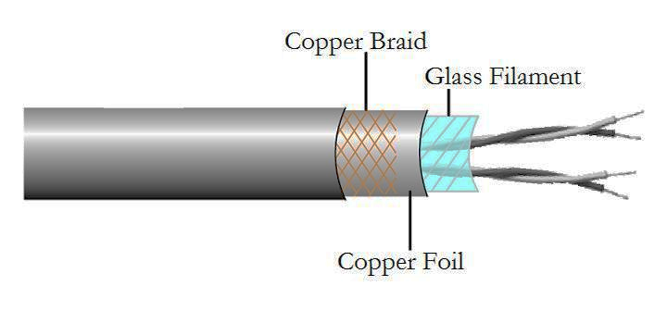
Twisted Pair Wires
Low frequency transmission medium
Separately insulated
Twisted together
Often “bundle” into cables
Usually installed in building during construction

Slide 9
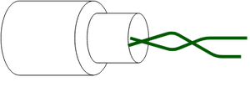

Types of Twisted Pair
Shielded Twisted Pair (STP)
⪧ The pair is wrapped with metallic foil to insulate the pair from electromagnetic interference.
Unshielded Twisted Pair (UTP)
⪧ Each wire is insulate with plastic wrap, but the pair is encased in an outer covering.

Slide 10
Twisted Pair
Applications
Twisted Pair cables are used in telephone lines to provide data and voice channels.
The DSL lines make use of these cables.
Local Area Networks (LAN) also make use of twisted pair cables.
They can be used for both analog and digital transmission.

Slide 11
Twisted Pair
Advantages
Inexpensive and readily available
Flexible and light weight
Easy to work with and install
Disadvantages
Susceptibility to interference and noise
Attenuation problem
Relatively low bandwidth (3000 Hz)

Slide 12
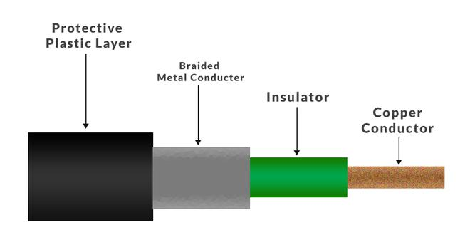
Coaxial Cable
Also called ‘Coax’
Has a inner conductor surrounded by a braided mesh
Both conductors share a common center axial, hence the term “co-axial”

Slide 13
Structure of Coaxial Cable
Copper conductor : A central conductor, which consists of copper. The conductor is the point at which data transmits.
Insulator : Dielectric plastic insulation around the copper conductor. it is used to maintain the spacing between the center conductor and shield.
Braided mesh : The braid provides a barrier against EMI moving into and out of the coaxial cable.
Protective plastic layer: An external polymer layer, which has a plastic coating. It is used to protect internal layers from damages.

Slide 14
Types of Coaxial cables
Hardline coaxial cable
Flexible coaxial cable
Semi-rigid coaxial cable
Formable coaxial cable
Twin-axial cable
Tri-axial cable
Rigid coaxial cable

Slide 15
Coaxial Cable
Applications
Coaxial cable used for television would be 75 Ohm and RG-6 coaxial cable.
Coaxial cables are also used for carrying internet signals, RG-6 cables are used for this.
The coaxial cables are also used in CCTV systems and both RG-59 AND RG-6 cables can be used.
The coaxial cables are also used in video Transmission the RG-6 is used for better digital signals and RG-59 for lossless transmission of video signals.

Slide 16
Coaxial Cable
Advantages
Higher bandwidth (400 to 600Mhz) & (up to 10,800 voice conversation)
Can be tapped easily (pros and cons)
Much less susceptible to interference than twisted pair
Disadvantages
High attenuation rate makes it expensive over long distance
As a Coaxial cable has multiple layers it is very bulky.
The coaxial cable must be grounded in order to prevent any crosstalk.

Slide 17
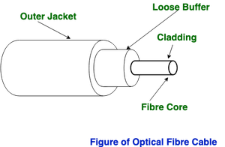
Optical Fiber
An Optical Fiber is a cylindrical fiber of glass which is hair thin size or any transparent dielectric medium. The fiber which is used for optical communication is waveguides made of transparent dielectrics.

Slide 18
Types of Optical Fiber
Generally optical fiber is classified into two categories based on:
The number of modes -
The refractive index -
a. Single-mode fiber b. Multi-mode fiber
a. Step-index optical fiber b. Graded index optical fiber

Slide 19
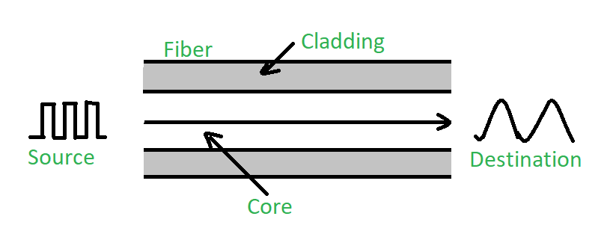
On the basis of the Number of Modes
a. Single-mode fiber :
only one type of ray of light can propagate through the fiber.
b. Multi-mode fiber :
Multimode fiber allows a large number of modes for the light ray traveling through it. The core diameter is generally (40um) and that of cladding is (70um).

Slide 20
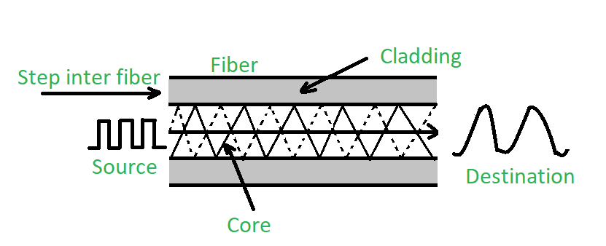
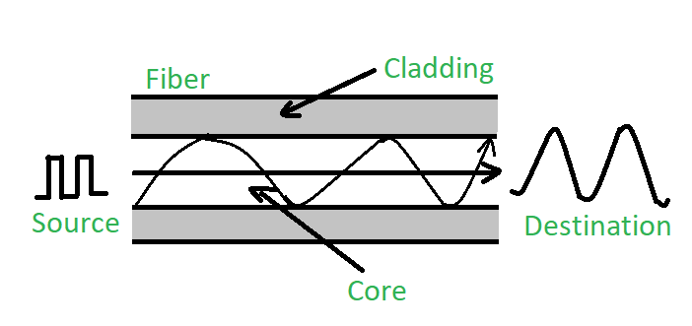
On the basis of Refractive Index:
a. Step-index optical fiber
The rays of light propagate through it in the form of meridional rays which cross the fiber axis during every reflection at the core-cladding boundary.
b. Graded index optical fiber
The core has a non-uniform refractive index that gradually decreases from the center towards the core-cladding interface.

Slide 21
Optical Fiber
Applications
Medical Industry
Communication
Defence
Industries
Broadcasting
Lighting and Decorations
Mechanical Inspections

Slide 22
Optical Fiber
Advantages
Increased capacity and bandwidth
Lightweight
Less signal attenuation
Immunity to electromagnetic interference
Resistance to corrosive materials
Disadvantages
Difficult to install and maintain
High cost
Fragile

Slide 23
Thank You…

